Slide 1
Country Club Location Evaluation
Bernard Beck

Slide 2
Problem to be Solved
Determining Our Club’s Next Club Location
You work for a country club development firm and have been tasked to determine where within the United States the next destination should be placed. The next facility will include a golf course, clubhouse, tennis facilities, swimming, gym, dining, as well as other operational infrastructure. The development area will be substantial. Care should be taken to locate areas within the United States offering the most reasonable land investment costs in coordination with a local customer base with discretionary income for country club membership.
Focus should be spent evaluating locations offering the lowest land values in conjunction with above average household incomes.

Slide 3
Interested Parties
Those with vested interest in these search parameters would include:
Company Stakeholders
Prospective Employees
Prospective Members
Possible Subcontractors
Numerous parties could be affected by this decision.

Slide 4
Data Acquisition
Data was obtained from the US Census Bureau and the American Enterprise Institute was utilized to evaluate our problem. The US Census data provided household incomes based on location while the AEI information narrowed down property values.
Income Data:
US Census Bureau: https://data.census.gov/cedsci/table?q=median%20income&g=0100000US.860000&tid=ACSST5Y2019.S1901&hidePreview=true
Land Value Data:
American Enterprise Institute: https://www.aei.org/housing/land-price-indicators/
Nationwide Zip Code Data:
http://federalgovernmentzipcodes.us/download.html

Slide 5
Interested Parties
Those with vested interest in these search parameters would include:
Company Stakeholders
Prospective Employees
Prospective Members
Possible Subcontractors
Numerous parties could be affected by this decision.

Slide 6
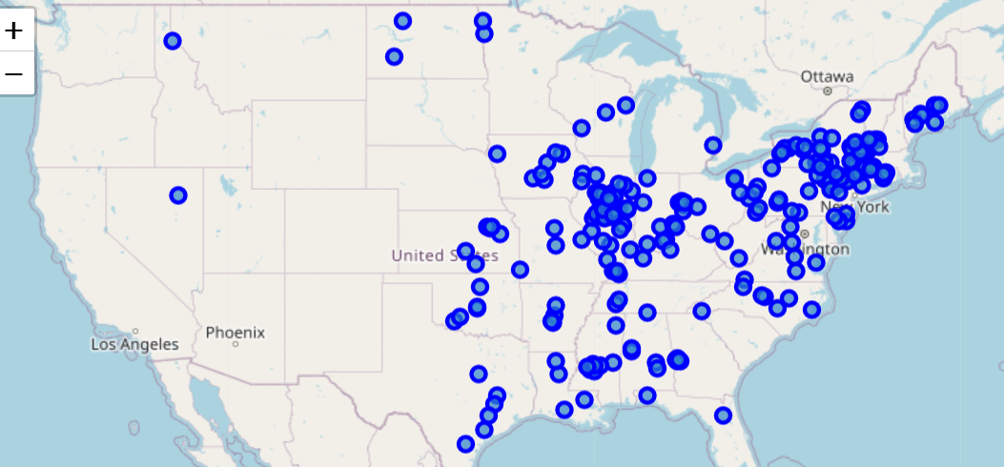
Starting Focus
The top 250 values are thoroughly focused throughout the Eastern and Midwest states.
We will narrow our focus from here.

Slide 7
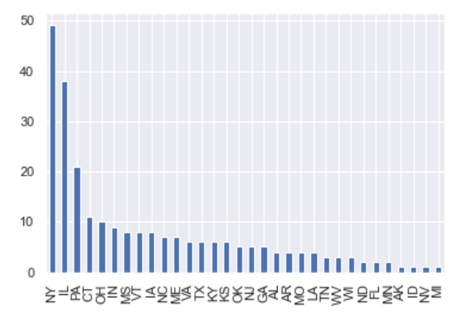
New York & Illinois
Of the top 250 value locations, nearly 100 are located within New York and Illinois. These two states dwarf the other states with respect to their potential.

Slide 8
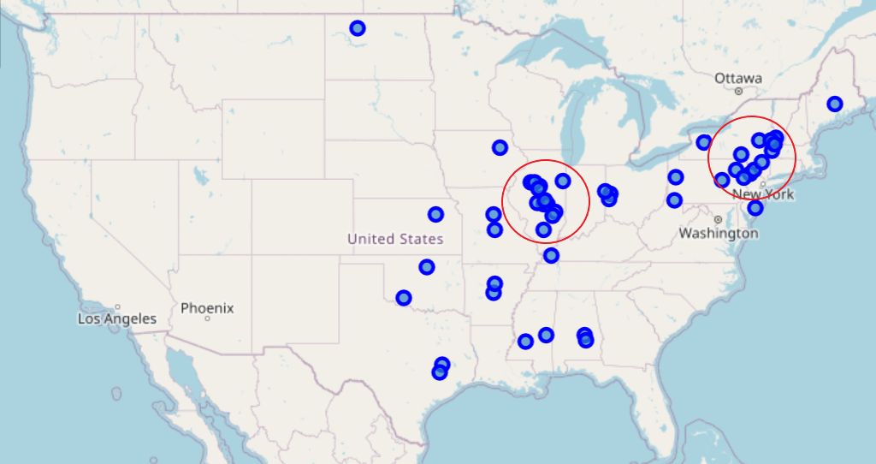
New York & Illinois Further Supported
Narrowing our search to the top 50 zip codes, we can see clear concentrations within New York and Illinois.
These states are pulling from the pack.

Slide 9
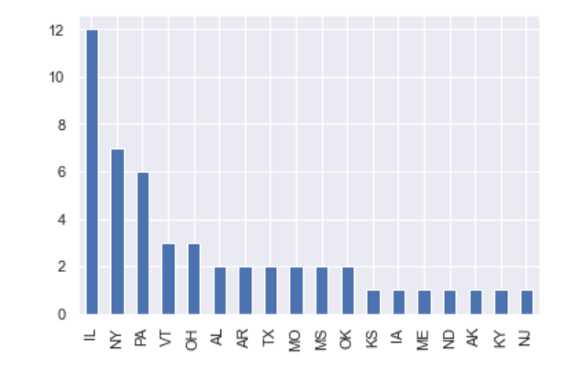
New York & Illinois Further Supported
Of the top 50 locations, Illinois shows up with 12 locations and New York with 7 locations.
24% of the 50 highest value opportunities show up in Illinois.

Slide 10
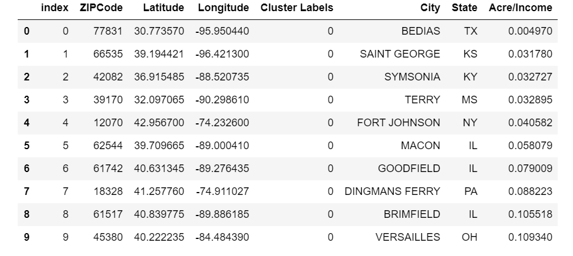
Illinois is Our Top Priority
Focusing upon the to 10 values across the country, 3 can be found within Illinois.

Slide 11
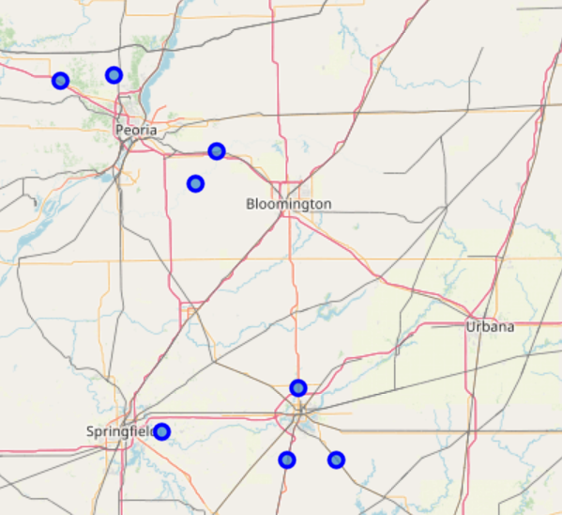
Bloomington, Peoria, Springfield
A 400 square-mile area surrounding Bloomington, Peoria, and Springfield Illinois contains 8 top 50 ratings.
Our next facility should show up in this tri-city area.

